Slide 1

Progressive Enhancement vs Graceful Degradation
An Ethical Issue
Jennifer Strickland
Friday, March 14, 2025
Approved for Public Release; Distribution Unlimited. Public Release Case Number 25-0528
Notes:
Image source: Creative Commons, airjmax on Flickr

Slide 2

Hi! I’m Jen Strickland.
Designer, Developer, Researcher, Strategist, Policy-wonk-in-training in D.C.
Today, I serve the public interest at The MITRE Corporation as an accessibility human-centered engineer supporting U.S. federal agencies.
To support local government, I volunteer with U.S. Digital Response.
I’m a master’s in public administration student at the Maxwell School of Citizenship & Public Affairs, Syracuse University.
In 2019 I became an Invited Expert with the Worldwide Web Consortium (W3C) Accessibility Guidelines Working Group. I chair a community group and am active on other working groups. If you’re looking to participate with the W3C, please reach out and I’ll help connect you.

Slide 3
Overview
Definitions
What’s the Big Deal?
Ouch! What to do
Thanks and Q&A

Slide 4

What is Ethical?
Notes:
Image source: Creative Commons cdn.slacker on Flickr

Slide 5
Definition Ethical
Merriam-Webster
Ethical: conforming to a high standard of morality or virtue
Moral: of or relating to principles of right and wrong in behavior
Rawls
“Principles of justice are chosen behind a veil of ignorance. This ensures that no one is advantaged or disadvantaged in the choice of principles by the outcome of natural chance or the contingency of social circumstances. Since all are similarly situated and no one is able to design principles to favor his particular condition, the principles of justice are the result of a fair agreement.”
Kant
Ethics requires an analysis of our moral concepts.
“First, unlike anything else, there is no conceivable circumstance in which we regard our own moral goodness as worth forfeiting simply in order to obtain some desirable object.
Second, possessing and maintaining a steadfast commitment to moral principles is the very condition under which anything else is worth having or pursuing.”
Michael Sandel Harvard professor of political philosophy and author of Justice
Principles of Justice
welfare of society
respect individual freedom
cultivating virtue, the attitudes and dispositions, the qualities of character, on which a good society depends
J. Patrick Dobel Univ of WA professor of public affairs and associate dean, Evans School of Public Affairs; author of Public Integrity.
Morals are a result of a process of reflective equilibrium; we “consider balance and coherence across actions, roles, and commitments.”
Notes:
Rawls source: Rawls, John. 1972. A Theory of Justice. Harvard University Press.
Kant source: Johnson, Robert and Adam Cureton, "Kant’s Moral Philosophy", The Stanford Encyclopedia of Philosophy (Fall 2024 Edition), Edward N. Zalta & Uri Nodelman (eds.), URL = <https://plato.stanford.edu/archives/fall2024/entries/kant-moral/>.
The first is that, as Kant and others have conceived of it, ethics initially requires an analysis of our moral concepts. We must understand the concepts of a “good will”, “obligation”, “duty” and so on, as well as their logical relationships to one another, before we can determine whether our use of these concepts is justified. Given that the analysis of concepts is an a priori matter, to the degree that ethics consists of such an analysis, ethics is a priori as a well.
Kant confirms this by comparing motivation by duty with other sorts of motives, in particular, with motives of self-interest, self-preservation, sympathy and happiness. He argues that a dutiful action from any of these motives, however praiseworthy it may be, does not express a good will. Assuming an action has moral worth only if it expresses a good will, such actions have no genuine “moral worth.” The conformity of one’s action to duty in such cases is only related by accident to morality. For instance, if one is motivated by happiness alone, then had conditions not conspired to align one’s duty with one’s own happiness one would not have done one’s duty. By contrast, were one to supplant any of these motivations with the motive of duty, the morality of the action would then express one’s determination to act dutifully out of respect for the moral law itself. Only then would the action have moral worth.
Sandel source: Sandel, Michael. 2009. Justice: What’s the Right Thing to Do? Farrar, Straus and Giroux.
Dobel source: Dobel, J. Patrick. 1999. Public Integrity. The Johns Hopkins University Press.

Slide 6

What is Progressive Enhancement?
Notes:
Image source: Creative Commons, Formerly SS_02_Camaro on Flickr

Slide 7
Definition Progressive Enhancement
“a design philosophy that provides a baseline of essential content and functionality to as many users as possible, while delivering the best possible experience only to users of the most modern browsers that can run all the required code.”
from MDN web docs https://developer.mozilla.org/en-US/docs/Glossary/Progressive_Enhancement
Notes:
The word progressive in progressive enhancement means creating a design that achieves a simpler-but-still-usable experience for users of older browsers and devices with limited capabilities, while at the same time being a design that progresses the user experience up to a more-compelling, fully-featured experience for users of newer browsers and devices with richer capabilities.
Feature detection is generally used to determine whether browsers can handle more modern functionality, while polyfills are often used to add missing features with JavaScript.
Special notice should be taken of accessibility. Acceptable alternatives should be provided where possible.
Progressive enhancement is a useful technique that allows web developers to focus on developing the best possible websites while making those websites work on multiple unknown user agents. Graceful degradation is related but is not the same thing and is often seen as going in the opposite direction to progressive enhancement. In reality both approaches are valid and can often complement one another.

Slide 8

What is Graceful Degradation?
Notes:
Image source: Creative Commons, Don Dailey on Flickr

Slide 9
Definition Graceful Degradation
“a design philosophy that centers around trying to build a modern website/application that will work in the newest browsers but falls back to an experience that while not as good still delivers essential content and functionality in older browsers.”
from MDN web docs https://developer.mozilla.org/en-US/docs/Glossary/Graceful_degradation
Notes:
Polyfills can be used to build in missing features with JavaScript, but acceptable alternatives to features like styling and layout should be provided where possible, for example by using the CSS cascade, or HTML fallback behavior.
It is a useful technique that allows Web developers to focus on developing the best possible websites, given that those websites are accessed by multiple unknown user-agents. Progressive enhancement is related but different — often seen as going in the opposite direction to graceful degradation. In reality both approaches are valid and can often complement one another.

Slide 10

Related Design Concepts Accessible Responsive Adaptive Sustainable
Notes:
Image source: Creative Commons, Mitch Prater on Flickr

Slide 11

Related Design Concepts
Accessible product, device, program, service, resource, or environment are fully available to all. (U. of VA)
Adaptive different designs for different device sizes (Aaron Gustafson)
Sustainable approach to designing services putting people and planet first (sustainablewebdesign.org)
Responsive “design for the ebb and flow of things” (Ethan Marcotte)
Notes:
Background image source: Microsoft stock image
Accessible: https://academicaccessibility.virginia.edu/what-does-accessibility-mean
Adaptive: Adaptive Web Design: Crafting Rich Experiences With Progressive Enhancement (Voices That Matter) 2nd Edition, by Aaron Gustafson. November 30, 2015, New Riders Publisher.
Responsive: Responsive Web Design by Ethan Marcotte. May 25, 2010, https://alistapart.com/article/responsive-web-design/
Sustainable: https://sustainablewebdesign.org

Slide 12


Responsive vs Adaptive
Responsive design delivers one fluid design for all devices. It is not just stacking items or fitting devices.
Adaptive design is created for select device sizes only.
Notes:
Responsive web design is one fluid website that flexibly adapts size and functionality of the device, increasing usability and access for all devices. This minimizes resources used to deliver the site, and in turn the amount of energy and effort to maintain it.
Without responsive design, web content might overflow or not use the space available. With the increasing variety in device sizes, responsive web design is considered a best practice.
Sources: Ethan Marcotte. Responsive Web Design. 2010. A List Apart, https://alistapart.com/article/responsive-web-design/. Last accessed September 27, 2022. Animation https://css-tricks.com/the-difference-between-responsive-and-adaptive-design/. (image source, too)

Slide 13

What’s the Big Deal?
Notes:
Image source: Microsoft stock images

Slide 14

Device Fragmentation Landscape
Device fragmentation occurs when people run older versions of an operating system while others update to latest version.
When you think of building an app, what do you think of? Smartphone, right?
People have tablets, watches, smart homes, wearables, TVs, refrigerators, game consoles, cars…
How often do you consider how your experience will work there?
Notes:
Background image source: DeviceAtlas https://deviceatlas.com/blog/iphone-fragmentation-why-detecting-model-essential

Slide 15
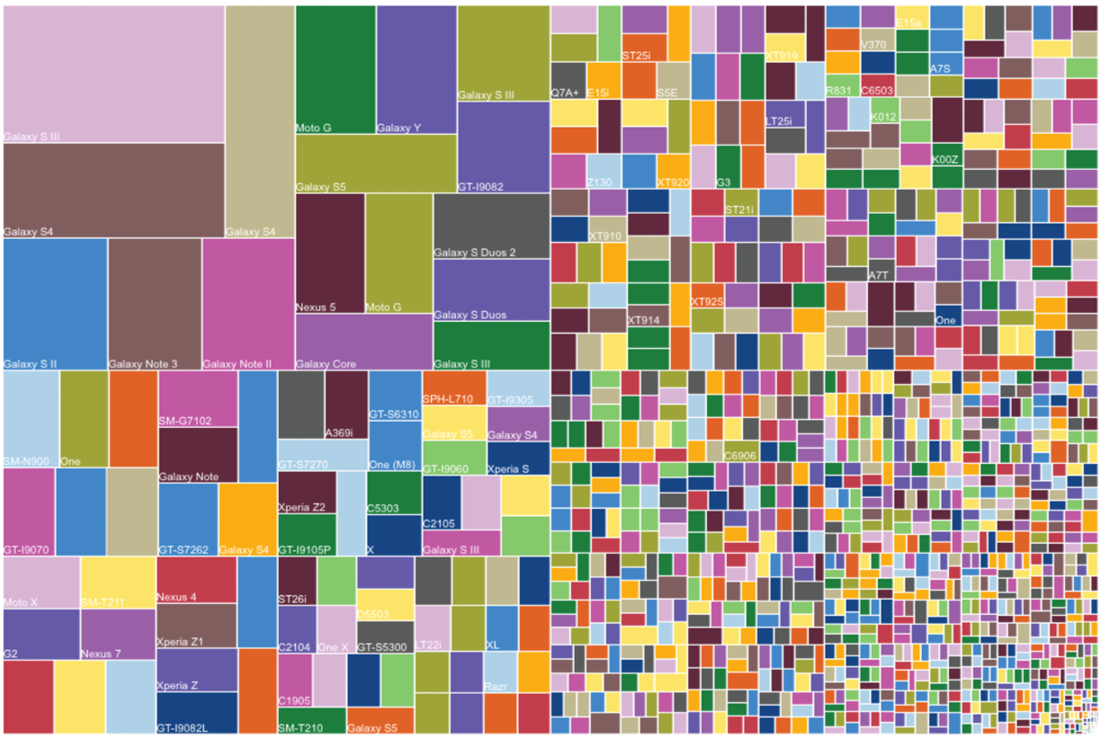
Android Fragmentation
Source: https://smartbear.com/blog/android-fragmentation-web-app-quality/
Notes:
Image source: https://smartbear.com/blog/android-fragmentation-web-app-quality/

Slide 16
Android Fragmentation: Market Share
Android OS version | Market Share
10 (Android 10) | 32.9 %
9.0 (Pie) | 17.6 %
11 (Android 11) | 17.3 %
8.0-8.1 (Oreo) | 13.7 %
7.0-7.1 (Nougat) | 7.4 %
6.0 (Marshmallow) | 5.0 %
5.0-5.1 (Lollipop) | 4.0 %
4.4 (KitKat) | 1.4 %
4.1-4.3 (Jelly Bean) | 0.5 %
4.0 (Ice Cream Sandwich) | 0.1 %
Source: App Brain Statistics https://www.appbrain.com/stats/top-android-sdk-versions
Notes:
Image source: https://smartbear.com/blog/android-fragmentation-web-app-quality/

Slide 17
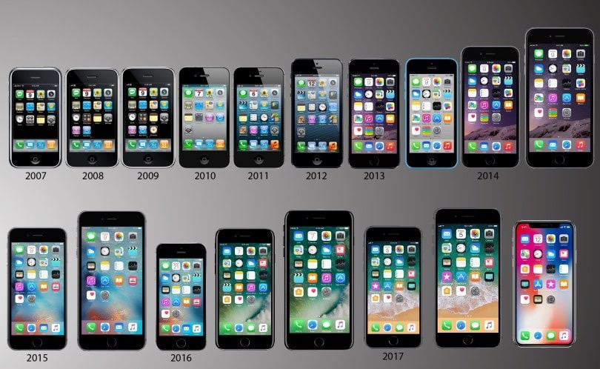
iPhone Fragmentation Over the Years
Source: https://deviceatlas.com/blog/iphone-fragmentation-why-detecting-model-essential
Notes:
Image source: https://deviceatlas.com/blog/iphone-fragmentation-why-detecting-model-essential

Slide 18
iPhone Fragmentation: Size
Family & Model | Logical Width | Logical Height | Physical Width | Physical Height | PPI | Scale Factor | Screen Diagonal | Aspect Ratio | Release
iPhone 16 Pro Max | 440 | 956 | 1320 | 2868 | 460 | 3 | 6.9" | 9:21 | 2024-09-09
iPhone 16 Pro | 402 | 874 | 1206 | 2622 | 460 | 3 | 6.3" | 9:21 | 2024-09-09
iPhone 16 Plus | 430 | 932 | 1290 | 2796 | 460 | 3 | 6.7" | 9:21 | 2024-09-09
iPhone 16 | 393 | 852 | 1179 | 2556 | 460 | 3 | 6.1" | 9:21 | 2024-09-09
iPhone 15 Pro Max | 430 | 932 | 1290 | 2796 | 460 | 3 | 6.7" | 9:21 | 2023-09-22
iPhone 15 Pro | 393 | 852 | 1179 | 2556 | 460 | 3 | 6.1" | 9:21 | 2023-09-22
iPhone 15 Plus | 430 | 932 | 1290 | 2796 | 460 | 3 | 6.7" | 9:21 | 2023-09-22
iPhone 15 | 393 | 852 | 1179 | 2556 | 460 | 3 | 6.1" | 9:21 | 2023-09-22
iPhone 14 Plus | 428 | 926 | 1284 | 2778 | 458 | 3 | 6.7" | 9:21 | 2022-10-07
iPhone 14 Pro Max | 430 | 932 | 1290 | 2796 | 460 | 3 | 6.7" | 9:21 | 2022-09-16
iPhone 14 Pro | 393 | 852 | 1179 | 2556 | 460 | 3 | 6.1" | 9:21 | 2022-09-16
iPhone 14 | 390 | 844 | 1170 | 2532 | 460 | 3 | 6.1" | 9:21 | 2022-09-16
iPhone SE 3rd gen | 375 | 667 | 750 | 1334 | 326 | 2 | 4.7" | 9:16 | 2022-03-08
iPhone 13 | 390 | 844 | 1170 | 2532 | 460 | 3 | 6.06" | 9:21 | 2021-09-14
iPhone 13 mini | 375 | 812 | 1080 | 2340 | 476 | 3 | 5.42" | 9:21 | 2021-09-14
iPhone 13 Pro Max | 428 | 926 | 1284 | 2778 | 458 | 3 | 6.68" | 9:21 | 2021-09-14
iPhone 13 Pro | 390 | 844 | 1170 | 2532 | 460 | 3 | 6.06" | 9:21 | 2021-09-14
iPhone 12 | 390 | 844 | 1170 | 2532 | 460 | 3 | 6.06" | 9:21 | 2020-10-13
iPhone 12 mini | 375 | 812 | 1080 | 2340 | 476 | 3 | 5.42" | 9:21 | 2020-10-13
iPhone 12 Pro Max | 428 | 926 | 1284 | 2778 | 458 | 3 | 6.68" | 9:21 | 2020-10-13
iPhone 12 Pro | 390 | 844 | 1170 | 2532 | 460 | 3 | 6.06" | 9:21 | 2020-10-13
iPhone SE 2nd gen | 375 | 667 | 750 | 1334 | 326 | 2 | 4.7" | 9:16 | 2020-04-24
iPhone 11 Pro Max | 414 | 896 | 1242 | 2688 | 458 | 3 | 6.46" | 9:21 | 2019-09-20
iPhone 11 Pro | 375 | 812 | 1125 | 2436 | 458 | 3 | 5.85" | 9:21 | 2019-09-20
iPhone 11 | 414 | 896 | 828 | 1792 | 326 | 2 | 6.1" | 9:21 | 2019-09-20
iPhone XR | 414 | 896 | 828 | 1792 | 326 | 2 | 6.06" | 9:21 | 2018-10-26
iPhone XS Max | 414 | 896 | 1242 | 2688 | 458 | 3 | 6.46" | 9:21 | 2018-09-21
iPhone XS | 375 | 812 | 1125 | 2436 | 458 | 3 | 5.85" | 9:21 | 2018-09-21
iPhone X | 375 | 812 | 1125 | 2436 | 458 | 3 | 5.85" | 9:21 | 2017-11-03
iPhone 8 Plus | 414 | 736 | 1080 | 1920 | 401 | 3 | 5.5" | 9:16 | 2017-09-22
iPhone 8 | 375 | 667 | 750 | 1334 | 326 | 2 | 4.7" | 9:16 | 2017-09-22
iPhone 7 Plus | 414 | 736 | 1080 | 1920 | 401 | 3 | 5.5" | 9:16 | 2016-09-16
iPhone 7 | 375 | 667 | 750 | 1334 | 326 | 2 | 4.7" | 9:16 | 2016-09-16
iPhone SE 1st gen | 320 | 568 | 640 | 1136 | 326 | 2 | 4" | 9:16 | 2016-03-31
iPhone 6s Plus | 414 | 736 | 1080 | 1920 | 401 | 3 | 5.5" | 9:16 | 2015-09-25
iPhone 6s | 375 | 667 | 750 | 1334 | 326 | 2 | 4.7" | 9:16 | 2015-09-25
iPhone 6 Plus | 414 | 736 | 1080 | 1920 | 401 | 3 | 5.5" | 9:16 | 2014-09-19
iPhone 6 | 375 | 667 | 750 | 1334 | 326 | 2 | 4.7" | 9:16 | 2014-09-19
iPhone 5C | 320 | 568 | 640 | 1136 | 326 | 2 | 4" | 9:16 | 2013-09-20
iPhone 5S | 320 | 568 | 640 | 1136 | 326 | 2 | 4" | 9:16 | 2013-09-20
iPhone 5 | 320 | 568 | 640 | 1136 | 326 | 2 | 4" | 9:16 | 2012-09-21
iPhone 4S | 320 | 480 | 640 | 960 | 326 | 2 | 3.5" | 3:4 | 2011-10-14
iPhone 4 | 320 | 480 | 640 | 960 | 326 | 2 | 3.5" | 3:4 | 2010-06-21
iPhone 3GS | 320 | 480 | 320 | 480 | 163 | 1 | 3.5" | 3:4 | 2009-06-19
iPhone 3G | 320 | 480 | 320 | 480 | 163 | 1 | 3.5" | 3:4 | 2008-07-11
iPhone 1st gen | 320 | 480 | 320 | 480 | 163 | 1 | 3.5" | 3:4 | 2007-06-29
Notes:
Data source: https://www.ios-resolution.com

Slide 19
iPhone Fragmentation: Market Share
iPhone OS version | Market Share
iOS 18.3 | 1.3
iOS 18.2 | 15.09
iOS 18.1 | 44.8
iOS 18.0 | 3.36
iOS 17.7 | 1.93
iOS 17.6 | 9.01
iOS 17.5 | 3.18
iOS 17.4 | 1.32
iOS 17.3 | 0.61
iOS 17.2 | 0.43
iOS 17.1 | 0.56
iOS 17.0 | 0.31
iOS 16.7 | 3.51
iOS 16.6 | 1.38
iOS 16.5 | 0.49
iOS 16.4 | 0.25
iOS 16.3 | 1.18
iOS 16.2 | 0.68
iOS 16.1 | 1.32
iOS 15.8 | 2.94
iOS 12.5 | 0.95
Source: StatCounter, Global Stats, January 2025, https://gs.statcounter.com/ios-version-market-share/
Notes:
Image source: https://deviceatlas.com/blog/iphone-fragmentation-why-detecting-model-essential; StatCounter, Global Stats, January 2025, https://gs.statcounter.com/ios-version-market-share

Slide 20
iPhone Fragmentation: Processing Power
Model | GPU | CPU | Internal Storage (GB) | RAM
iPhone XS Max | Apple GPU (4-core graphics) | Hexa-core (2x2.5 GHz Vortex + 4x1.6 GHz Tempest) | 64/256/512 | 4 GB
iPhone XS | Apple GPU (4-core graphics) | Hexa-core (2x2.5 GHz Vortex + 4x1.6 GHz Tempest) | 64/256/512 | 4 GB
iPhone XR | Apple GPU (4-core graphics) | Hexa-core (2x2.5 GHz Vortex + 4x1.6 GHz Tempest) | 64/128/256 | 3 GB
iPhone X | Apple GPU (three-core graphics) | Hexa-core 2.39 GHz (2x Monsoon + 4x Mistral) | 64/256 | 3 GB
iPhone 8 | Apple GPU (three-core graphics) | Hexa-core (2x Monsoon + 4x Mistral) | 64/256 | 2 GB
iPhone 8 Plus | Apple GPU (three-core graphics) | Hexa-core (2x Monsoon + 4x Mistral) | 64/256 | 3 GB
iPhone 7 | PowerVR Series7XT Plus (six-core graphics) | Quad-core 2.34 GHz (2x Hurricane + 2x Zephyr) | 32/128/256 | 2 GB
iPhone 7 Plus | PowerVR Series7XT Plus (six-core graphics) | Quad-core 2.34 GHz (2x Hurricane + 2x Zephyr) | 32/128/256 | 3 GB
iPhone 6 | PowerVR GX6450 (quad-core graphics) | Dual-core 1.4 GHz Typhoon (ARM v8-based) | 16/32/64/128 | 1 GB
iPhone 6S | PowerVR GT7600 (six-core graphics) | Dual-core 1.84 GHz Twister | 16/32/64/128 | 2 GB
iPhone 6S Plus | PowerVR GT7600 (six-core graphics) | Dual-core 1.84 GHz Twister | 16/32/64/128 | 2 GB
iPhone SE | PowerVR GT7600 (six-core graphics) | Dual-core 1.84 GHz Twister | 16/32/64/128 | 2 GB
iPhone 5S | PowerVR G6430 (quad-core graphics) | Dual-core 1.3 GHz Cyclone (ARM v8-based) | 16/32/64 | 1 GB
Source: Device Atlas, 2014, https://deviceatlas.com/blog/iphone-fragmentation-why-detecting-model-essential
There’s a video showing side-by-side performance tests of iPhones: https://www.idownloadblog.com/2014/09/22/video-comparison-all-iphones/
Notes:
In 2018, iPhone 6 - with its relatively tiny 1GB was still the most popular smartphone in some countries (e.g., Spain, Philippines and Mexico) and commanded around 5% market share in most other countries.
Image source: https://deviceatlas.com/blog/iphone-fragmentation-why-detecting-model-essential

Slide 21
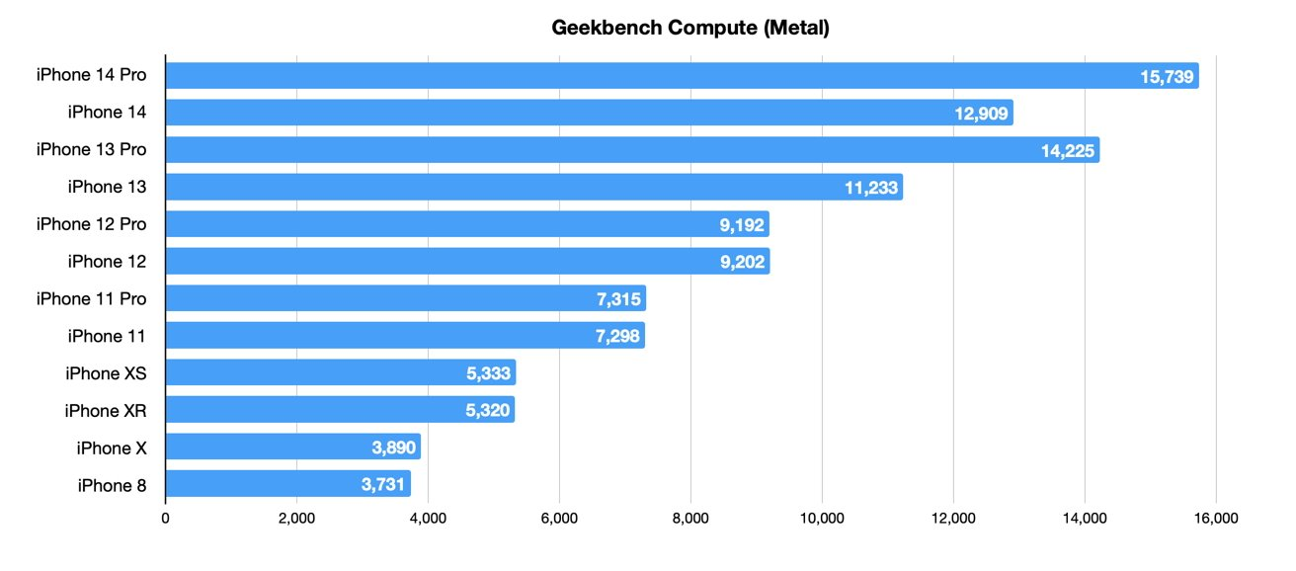
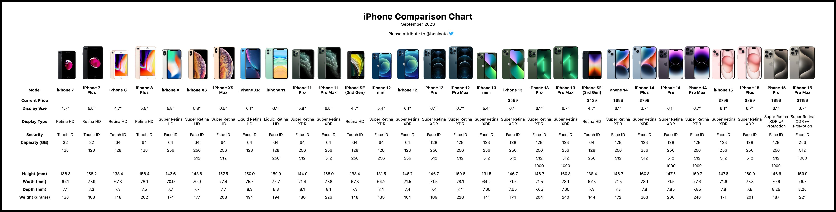
iPhone Fragmentation: Capabilities
Sources: iPhone Comparison Chart: Joe Beninato on X: https://x.com/beninato/status/1703964667893399945/photo/1. Geekbench Computer: AppleInsider, https://appleinsider.com/articles/22/09/26/how-iphone-speeds-have-grown-in-the-last-5-years
iPhone capabilities vary a lot, and Geekbench’s Metal test shows GPU advancements can be huge, so differences between models can be quite dramatic.
Notes:
Sources: iPhone Comparison Chart: Joe Beninato on X: https://x.com/beninato/status/1703964667893399945/photo/1. Geekbench Computer: AppleInsider, https://appleinsider.com/articles/22/09/26/how-iphone-speeds-have-grown-in-the-last-5-years

Slide 22

Imagine that for every service and device… Android, Windows, tablets, TVs, cars, wearables, etc.
Notes:
Image source: Microsoft stock images

Slide 23
Why are modern websites slower? [and thereby emitting more greenhouse gas, wearing out devices]
Mostly due to the heavy embedded JavaScript and/or CSS frameworks.
Sites are designed and built for the latest devices and fast bandwidth connections.
The Growth of Web Page Size
803kb
2012
1850kb
2014
2,200kb
2016
2,284kb
2022
2,652kb
2024
Source: KeyCDN.com. (2022). The Growth of Web Page Size and The Web Almanac, 2024.
Notes:
Source
The Growth of Web Page Size, November 18, 2022, https://www.keycdn.com/support/the-growth-of-web-page-size
And the Web Almanac for 2024, https://almanac.httparchive.org/en/2024/page-weight
Also, speaking to the impact of web performance on accessibility, as the slower a site the harder it is for assistive technology to connect to it, if it can at all. https://marcysutton.com/accessibility-and-performance

Slide 24

Ouch! What to do…
Notes:
Image source: Creative Commons, Garrett Scott on Flickr

Slide 25

Why I assert progressive enhancement is more ethical…
By providing basic features, stability across all browsers and devices, everyone can access and have a better shot at positive outcomes.
Core Principles of Progressive Enhancement
Basic content should be accessible to all web browsers.
Basic functionality should be accessible to all web browsers.
Sparse, semantic markup contains all content.
Enhanced layout provided by externally linked CSS.
Enhanced behavior provided by unobtrusive, externally linked JavaScript.
End-user web browser preferences are respected.
No JavaScript / CSS frameworks that only work for the latest couple versions of tech
Source: What is Progressive Enhancement, and why it matters, by Praveen Dubey. November 26, 2018. free code camp: https://www.freecodecamp.org/news/what-is-progressive-enhancement-and-why-it-matters-e80c7aaf834a/
Notes:
Image source: Microsoft stock images

Slide 26


Progressive Enhancement vs Graceful Degradation
Both graceful degradation and progressive enhancement consider how well a site works in a variety of browsers on a variety of devices. The key is where they place their focus and how this affects workflow.
Progressive enhancement focus on content, not devices or browsers
Content is what people need.
Enhancement… enhances!
Progressive enhancement mindset starts from the content out
Start with content, then style, then behavior
Graceful degradation focus on the most advanced tech
Testing older, less capable tech happens at development end, usually just previous version
Older tech has a lesser, passable experience, only intolerable issues are fixed, if found
Sources: Understanding Progressive Enhancement by Aaron Gustafson, October 07, 2008. A List Apart: https://alistapart.com/article/understandingprogressiveenhancement/
The Role of Enhancement in Web Design. Raluca Budiu, NN Group, May 1, 201.6 https://www.nngroup.com/articles/enhancement/
Notes:
Image source: Microsoft stock images

Slide 27


Deliver just what’s needed
Deliver the content.
Identify the key functionality of the feature you want to implement.
Provide this functionality with the simplest technology.
Enhance!
Notes:
Image source: Microsoft stock images
Progressive Enhancement is not anti-JavaScript: https://saptaks.blog/posts/progressive-enhancement-is-not-anti-js.html

Slide 28
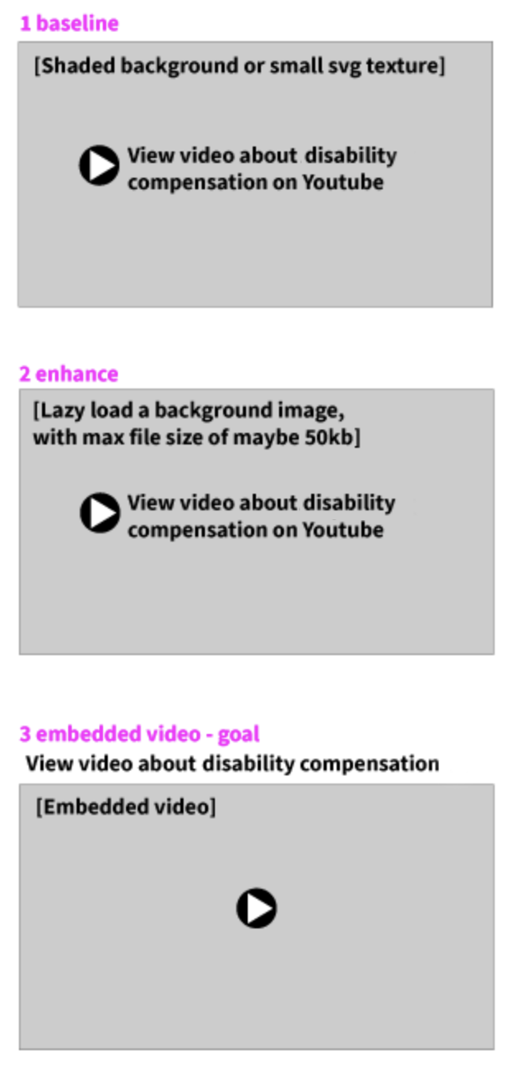
How to Progressive Enhancement example
1 baseline experience
The first deliverable would be the linked video title text, as follows, perhaps inside a shaded box created with HTML; the entire box may be clickable.
<a title="Go to video about disability compensation" class="video-link" href="https://www.youtube.com/watch?time_continue=3&amp;v=xE0LzeRgdAk" target="_blank" rel="noopener "> View video about disability compensation <dfn>on Youtube</dfn> </a>
2 enhancement
Next, enhance the experience with lazy loaded video thumbnail image.
Add an image, after the page loads to fill in a shaded box that is the dimensions of the image.
Another treatment might be to only load the image at a certain width.
Visit Floodsmart.gov and resize your browser. Watch the image of the people be replaced by a textured SVG graphic. This uses a tiny vector graphic repeated in the background, then replaces it with an image at a dimension that we can expect the user has sufficient connectivity.
<a title="Go to video about disability compensation" class="video-link" href="https://www.youtube.com/watch?time_continue=3&amp;v=xE0LzeRgdAk" target="_blank" rel="noopener "> View video about disability compensation <dfn>on Youtube</dfn> <img srcset="disability-compensation-480w.jpg 480w, disability-compensation-800w.jpg 800w" sizes="(max-width: 600px) 480px, 800px" src="disability-compensation-800w.jpg" alt="Director speaking about disability compensation" /> </a>
3 goal enhancement, embedded video(s)
The third option of including an embedded video requires additional technical discovery and depends upon your project’s requirements and constraints.
Example for Basic Video Card
Title
Description
Duration of video
Link to video service in a box with indication of external link
Enhancement 1
Same as above
Poster image of video with alt text
Set dimensions on poster container so that the screen will not shift when image loads
Enhancement 2
Same as above
Embedded video that does not auto-play, only play on user action
Include size of the video
Notes:
Paul Grenier, a11ySlack, WCAG: I did a lot of work researching how best to use the validity API and presented it at A11yTO a few years ago. https://bit.ly/a11yform. My conclusion: don't use it as is. But it can be very useful especially for progressive enhancement.
Progressive Enhancement is not anti-JavaScript: https://saptaks.blog/posts/progressive-enhancement-is-not-anti-js.html

Slide 29

Thank you so much! Any Questions?
Jennifer Strickland, jstrickland@mitre.org
Check out https://itk.mitre.org for design thinking resources
Notes:
Image source: Microsoft stock images

